Slide 1

What Might Determine A Successful Kickstarter Campaign
By Kevin Angotti

Slide 2

Introduction:
Since April 2009, Kickstarter has become a place millions of people have come to expand on their ideas, package them, and sell them to the world. There have been many high-profile products that stem from a Kickstarter campaign. Campaigns have won Grammys and Oscars and can be found almost everywhere you look.
This project looks to determine the best outcome one might have when creating goals and what factors might help campaigns become more successful.

Slide 3
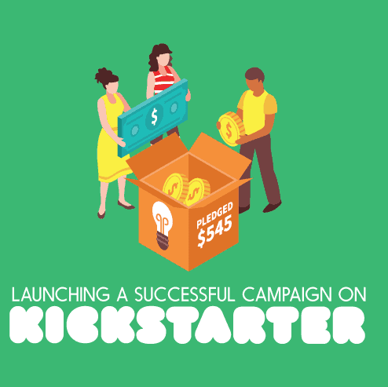
Research Questions:
Can a funding goal of a project be used to predict if the campaign will succeed?
What factors contribute the most to a Kickstarter campaign?
Is there a timeline that offers the best outcome for a successful campaign?
Does the number of backers directly relate to successful campaigns?

Slide 4
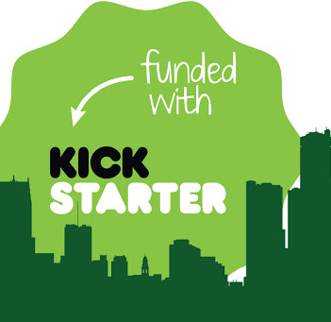
Methods:
When approaching the data for this project, I began by examining variables within the dataset. This took time due to the vast number of rows in the dataset. I used a combination of the R programming language, Python programming language, and Power BI.
To begin the project, I turned to R; I conducted summary statistics of the datasets to see initial trends and what each variable might have to tell me. I followed this up with a quick linear regression model to see what these trends might mean.
I then used Python to create all the data models that would be needed for analysis and predictions. The first model I created was a K-Modes clustering model; I then followed that with a linear regression model that scores on the mean squared error MSE, finally, a neural network.

Slide 5
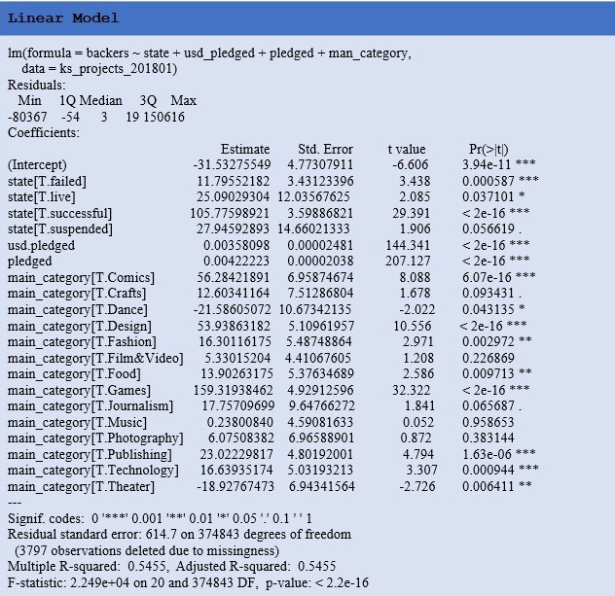
EDA:
R's initial linear model was for the backer's variable as a function of the state, usd_pledged, pledged(worldwide), and man_category. These variables provided some good insights, and all but three categories returned a p-value under the 0.05 threshold.
The F-statistic was 10.1134 and an adjusted R-squared was 0.5455.
Some values to highlight here, from the main_category items that stick out the most are comics, games, publishing, and design.

Slide 6
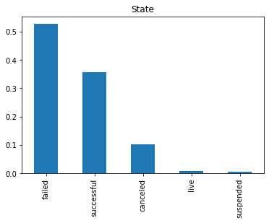
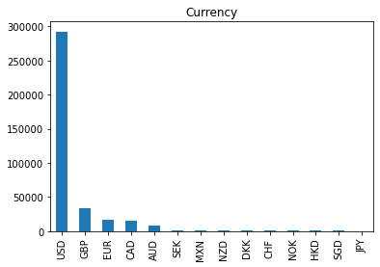
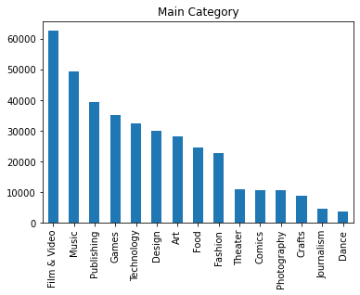
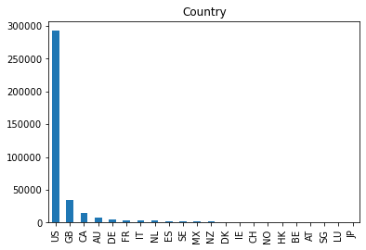
EDA Cont.

Slide 7
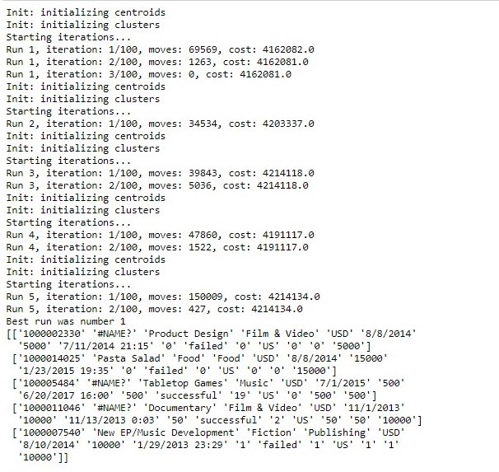
Modeling Cont.
In Python I first created a form of the K-Means clustering algorithm called K-Modes. This type of model handles categorical data very well. The model takes in the entire dataset and returns its prediction on each cluster's most common outcome.
Each time the model ran, the results returned the measured number of clusters; in this case, my last run returned a failed campaign in 3 of the 5 clusters. From those clusters, 3 of the failed campaigns were film & video, Food, and publishing. The two successful campaigns were music and a film & video. In all five clusters, the United States provided the most funding.

Slide 8
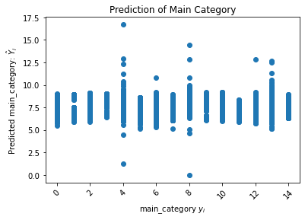
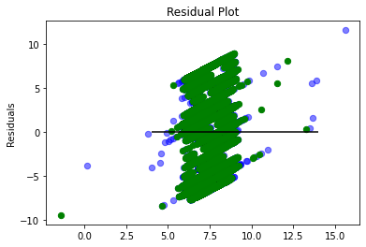
Modeling Cont.
The next model in Python was a linear regression model which took man_category as a target and utilized a 60/40 test, train, split. The result, returned predictions for each of the category types. The model, scored by MSE, returned 14.7 against the entire dataset and 15.3 for just man_category vs. usd_pledged.
Notes:
The thought process here was from the EDA analysis the United States was shown to provide the most funding to campaigns so, running a linear model just on the United States pledged amounts was a necessary step. The error did go up by a full point; however, it is still a strong model since this change was very little. I was only able to provide an accuracy of .26 to 0.31 percent

Slide 9
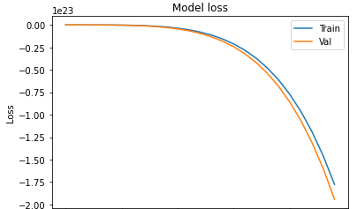
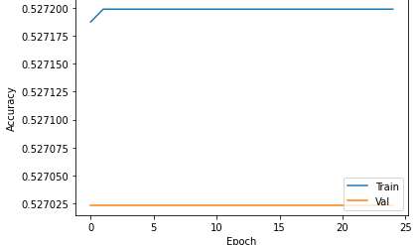
Modeling Cont.
The last model I created was a Neural Network. This was my first time running a successful NN on a dataset. The results were good and bad. I created two Neural networks with the setups as follows; the first had a dense or number of nodes as 11 for the input layer, output layer 1, with two hidden layers of 32. This model provided an accuracy of only 11%.
The second NN model had a better outcome, the input and output layers were the same as the first with 11 and output 1 but had three hidden layers of 1000, and this model returned 52-60% on runs.
Both were run on 25 passes or epochs with a batch size of 32, which was how many samples the model took.
I believe adjusting of the layers could help obtain better results. However, the main issue I ran into was CPU power and memory. The models I was able to run were not the inputs I would have like use. I had to reduce the epochs from the normal (100-150 )to 25 just to run the analysis.

Slide 10
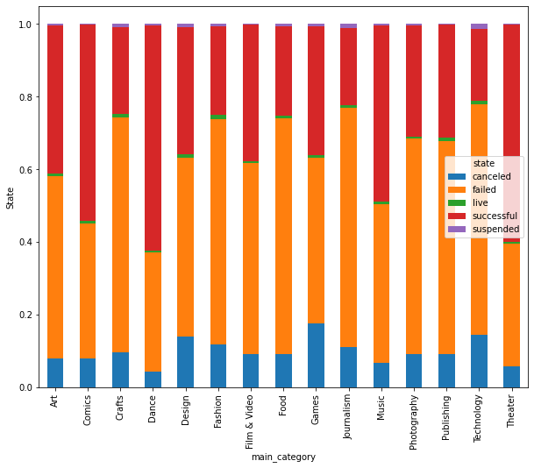
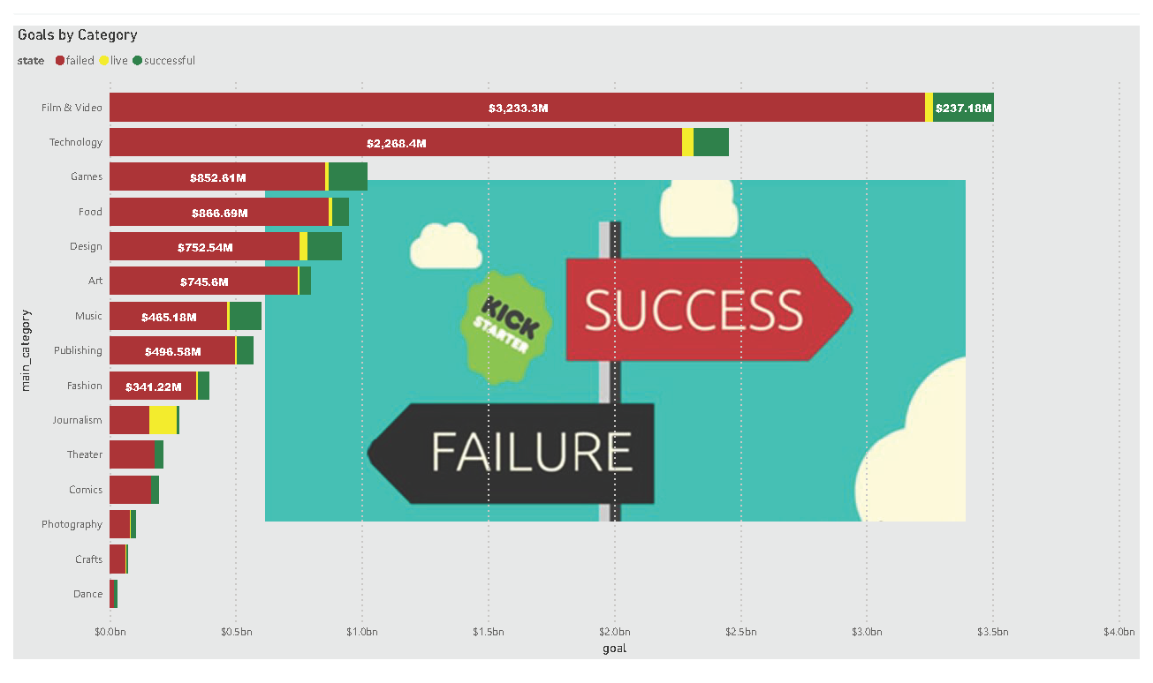
Discussion:

Slide 11
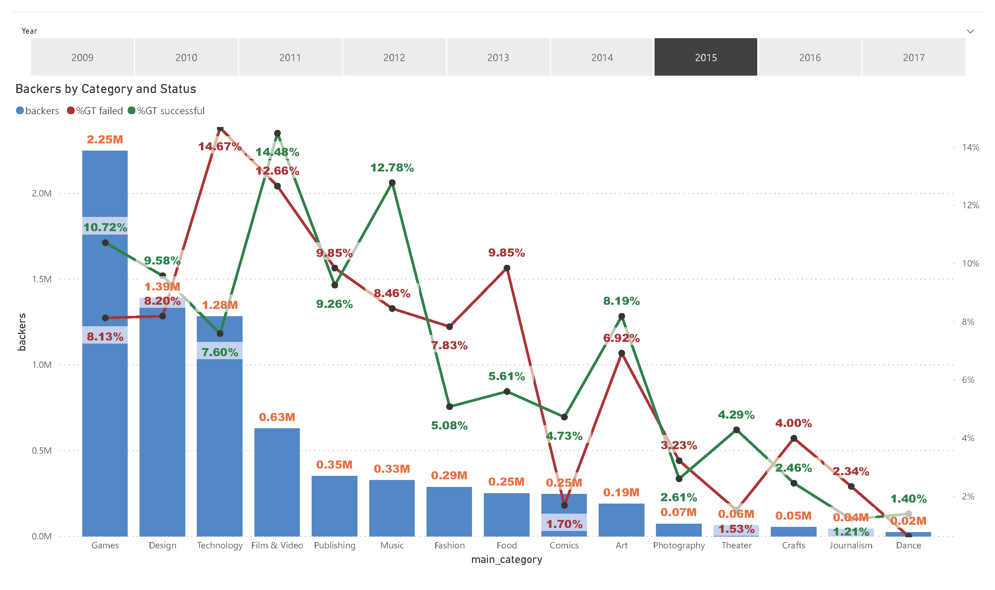

Slide 12
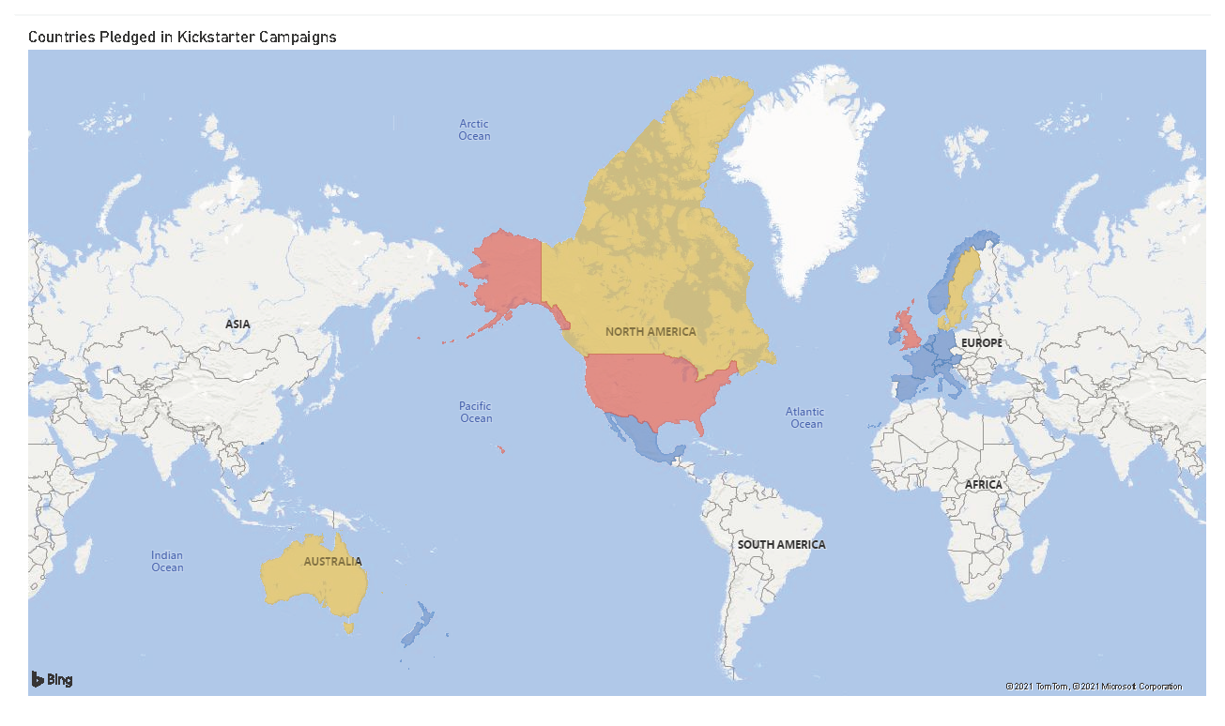

Slide 13
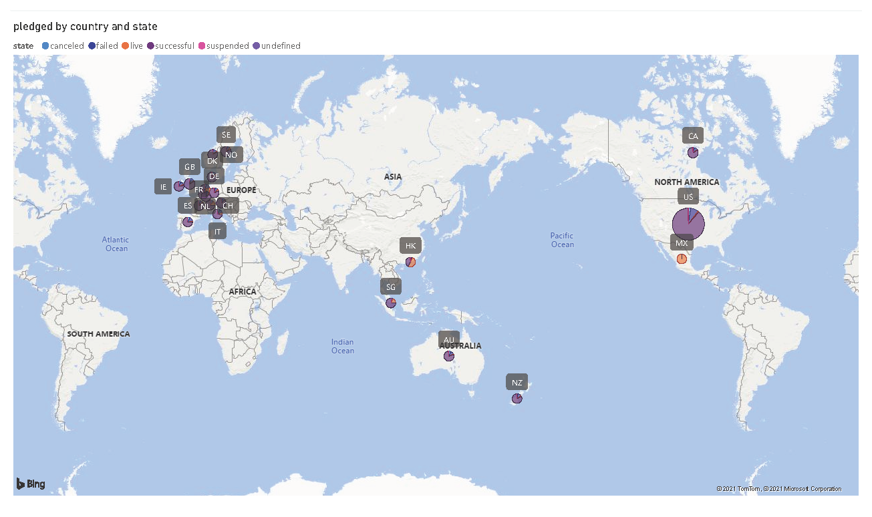

Slide 14
Conclusion:
Looking at Kickstarter data and trying to find insights became a real possibility and the analysis I was able to perform is just a small picture of the whole aspect of the questions I looked to answer. Digging deeper into which category and state were successful and determining the best category can be possible. This can help future entrepreneurs make better decisions on where to start or which category to place their products.
I was able to determine that the best categories someone looking to have a successful campaign tend to fall into Film & Video, Music, and Games.
I was able to use main_category as a target for prediction in each of my models and the results provided good insights into how successful those would be.
The major factors that contribute to a campaign seemed to be backers and the category chosen. Research suggested that backers go into the process of choosing a campaign with intent on knowing which categories they have in mind, making the main_category analysis highly insightful.
I was not able to investigate timeframe as intended, but this could be a good next step for the project.

